Slide 1

TEAM CUSAT
PROJECT NAME :
“ResQReady”

Slide 2

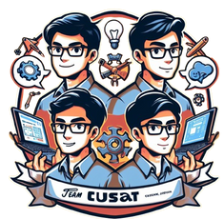
PROBLEM:
The In recent years, human suffering has increased due to the higher frequency and magnitude of disasters with natural and man-made causes across the globe These disasters have enormous negative impacts on human lives, properties, and infrastructures. In the last decade, every year, natural disasters killed near 75,000 and affected about 200 million people, while caused approximately 162.2 billion USD in economic losses which all are expected to increase in the future
7,5000 deaths every decade!!
The economic impact reaches a staggering $1.25 trillion.
India has experienced 1,058 natural disasters, including floods,
cyclones, droughts, cold waves, and heatwaves, between 1995
and 2020. According to this report, floods account for 33% of
these disasters, followed by heatwaves (24%), droughts (22%), cold waves (16%), and cyclones (5%).
Problem statement

Slide 3

Challenge:
Natural disasters cause significant human suffering and financial losses. While perfect prediction is impossible, many casualties and property damages could potentially be avoided with timely warnings and improved preparedness.
Current challenges include:
Lack of real-time alerts, especially in vulnerable areas with limited internet connectivity.
Limited access to educational resources and training for communities on disaster preparedness and response.
Difficulty coordinating relief efforts due to fragmented communication between first responders, organizations, and citizens.
Problem statement

Slide 4

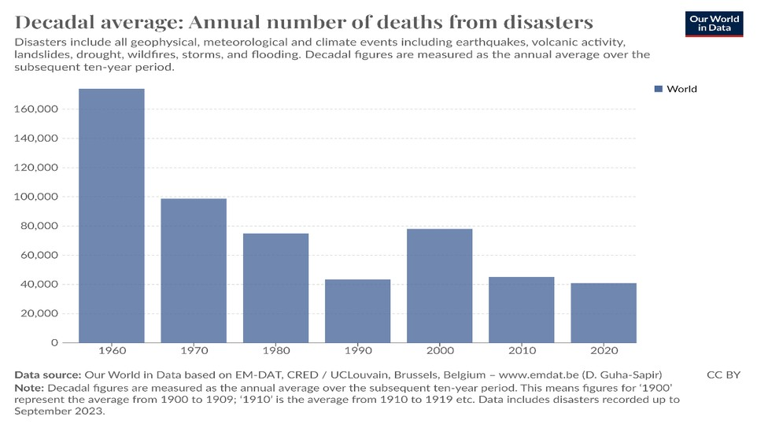

Human Impact:
According to Relief Web, natural disasters occurred 137 times in 2022, which is 137 fewer than the average of 141 disasters per year from 1992 to 2021. The number of deaths in 2022 was also 7,750,
which is lower than the average of
30,909 deaths per year from 1992 to 2023
Impacts
Some of the deadliest natural disasters in history include:
Economic Impact
Natural disasters can cause significant economic losses, affecting both human and economic activity. In 2020, natural disasters caused an estimated $190 billion in losses globally and affected 100 million people, resulting in 15,082 deaths. The World Bank estimates that natural disasters cause $520 billion in annual consumption loss globally,
which is 60% more than
commonly reported asset losses
Bhola Cyclone: Hit Bangladesh in
1970, killing an estimated 300,000
people Indian Ocean tsunami of 2004: Killed more than 225,000 people Tangshan earthquake of
1976: Resulting in more than
242,000 deaths In the United States, 97 natural disasters occurred in 2021, including 64 severe thunderstorms, 14 caused by wildfire, heat waves, and drought, and 12 due to floods and flash
floods.

Slide 5

S o l u t i o n
Introducing ResQReady, a real-time Disaster management system to enhance resilience and preparedness for effective Disaster Management
BUT!!
WHAT IS IT ?
A holistic disaster management solution encompasses real-time alerts, education, coordination, and support features, ensuring swift and effective response during crises. Through our innovative volunteer shelter network, individuals can register shelters to provide housing to those affected by disasters, fostering community solidarity and support. This crucial feature stands at the heart of our solution, enabling swift mobilization of resources and ensuring that no one is left without shelter during times of adversity
5

Slide 6


PHASE | PROBLEM | SOLUTION | CASE STUDIES
PRE DISASTER | Lack of awareness Data deficiencies: Language barriers real time alert infrastructure | AI-powered Chatbot: Provides interactive, data- driven information on disaster risks, preparedness measures, Educational Courses: Offers comprehensive yet engaging courses on a range of disaster preparedness topics tailored to diverse audiences. | Case Study: Chatbots like those used by FEMA (Federal Emergency Management Agency) provide real-time disaster information and answer user queries https://www.fema.gov/. Features: Access to accurate and up-to-date disaster risk information based on user location. Interactive guidance on creating emergency kits, developing evacuation plans, and practicing safety measures. Real-time updates on weather alerts and potential disasters.
 |  |  | Multilingual support to reach diverse communities.
DURING DISASTER
POST DISASTER | Resource limitations: Funding, manpower, and expertise are often scarce in the aftermath of a disaster. Meeting basic needs Mental health impact | Crowdfunding: Facilitates rapid fundraising for critical relief efforts. Volunteer Shelter Network: Connects displaced individuals with available temporary housing. AI-powered Chatbot: Provides real-time information, resources, and mental health support. | Case Study: GoFundMe played a critical role in raising funds for post-hurricane relief efforts in the Caribbean and US, demonstrating the power of crowdfunding https://www.gofundme.com Volunteer Shelter Network: Case Study: Airbnb's Open Homes program has successfully connected displaced people with temporary housing during disasters https://www.airbnb.com/help/article/2930
ADD ONS | A real time disaster alert broadcasting system | Disaster prediction from satalite images Disaster prediction from NLP analysis from social media apps | Providing a platform to connect first responders with Disaster response teams and NGO’s

Slide 7





Benefits of this comprehensive approach
Benefit 1: Reduce casualties and property damage through real-time alerts and improved preparedness.
Real-time alerts for immediate disaster notifications.
Tailored preparedness plans for personalized safety.
Interactive training for emergency response skills.
Community collaboration for collective resilience.
Feedback loop for real-time monitoring and improvement
Benefit 2:
Benefit 3:
Empower communities to take proactive measures through education and training.
Enhance response efficiency through seamless communication and coordination.
Facilitate disaster relief efforts through secure donation channels and volunteer opportunities.
Community education initiatives.
Practical training
programs.
Empowering local leaders.

Slide 8


Establishing Platforms
for Seamless Coordination
Creates a platform for facilitating communication and information sharing between first responders, organizations, and communities.
AI Chatbot for Interactive
Conversations
Integrates a 24/7 multilingual AI chatbot to provide personalized assistance and support related to disaster preparedness and response.

Slide 9


Real-time Alert and
Quick Response Delivers instant alerts via SMS, ensuring critical information reaches users even in low- connectivity areas.
Empowering Communities
Through Education and Training:
Provides comprehensive educational resources within the app to enhance community resilience in disaster management.

Slide 10
Fund Collection
Through Donations
Hosts a secure donation portal for users to contribute to disaster relief efforts.
Volunteer Shelter Network :
Enables users to register their shelters and volunteer housing for victims during disasters.

Slide 11
Establishing Platforms
for Seamless Coordination
Creates a platform for facilitating communication and information sharing between first responders, organizations, and communities.
Offline Shelter Information Access
stores shelter location and capacity data in a local app database, allowing the disaster management team to access this information even when internet connectivity is lost.

Slide 12
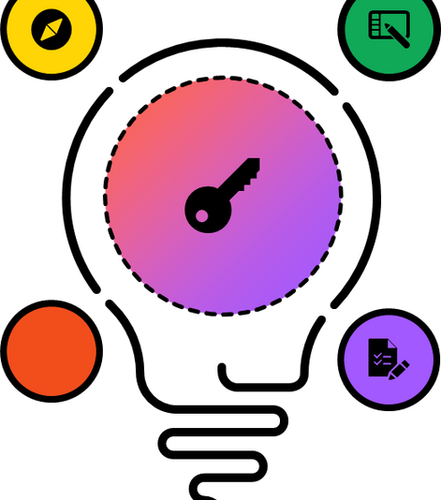

Technologies Used
Ai Prediction Models
at a SERVER
Android app:
Flutter/dart
Web App interface
Html Css JS
Flask
Multi-Lingual LLMs
Model Training: Google collab and kaggle.

Slide 13

government agencies,
maintenance costs promotional expenses
(servers, customer support)Partnership and
expense

Slide 14

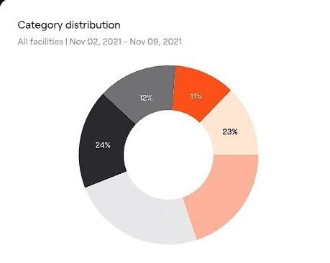
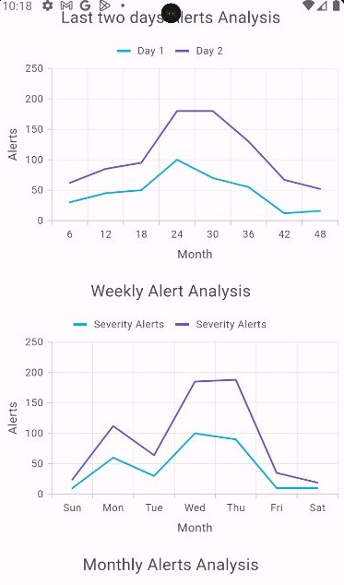
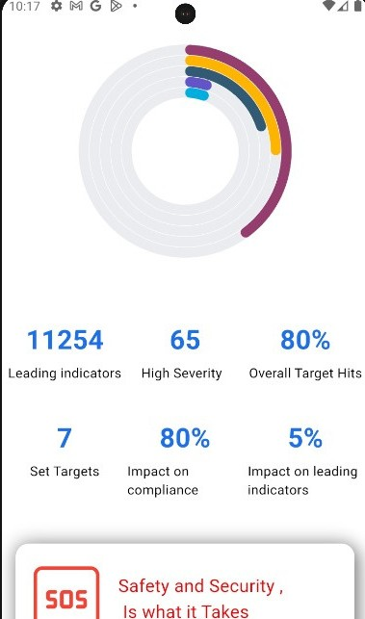
Data Visualization and Analytics in
Methodology
/ Architecture diagram
Disaster Data Visualization
Mobile app Trend Data analytics
Homepage With SOS button
These Graphical Representations Help Stakeholders, Users about possible disasters ,Recent climatic changes
,Comparison of alerts about recent disasters and severity of disasters .
13

Slide 15
Revenue Generation Plan:
Advertising Revenue:: Offer targeted advertising space within the app to disaster relief organizations, insurance companies, and emergency preparedness suppliers.Implement various ad formats, including banner ads, sponsored content, and video ads.Utilize targeted advertising based on user demographics, location, and behavior.
Partnerships and Sponsorships::Forge partnerships with government agencies, NGOs, and corporate sponsors to support app development and operations.Offer sponsorship opportunities for specific features, events, or initiatives within the app.Collaborate with sponsors to create co-branded content and marketing campaigns
Data Licensing and Analytics::Monetize app data assets by offering data licensing agreements to researchers, policymakers, and businesses.Provide access to data analytics tools and dashboards for disaster trend analysis and risk management.Offer customized data reports and research services to clients seeking in-depth analysis..
E-commerce Integration:: Integrate an e-commerce platform within the app to sell emergency preparedness kits and survival gear. Curate a selection of products from trusted suppliers and manufacturers.Implement affiliate marketing programs to earn commissions on product sales.This revenue generation plan leverages advertising, partnerships, data monetization, and e- commerce integration to create a diversified revenue stream for sustained profitability and growth.

Slide 16
THANK YOU
Team CUSAT
Sajad Hussain---------□ Design/Research Ruvais P -----------□ App Development
Adarsh Singh --□ Web App development /Database Management Avinash Singh -□ Machine Learning /Model training and deployment

